Slide 1
Collatz’s conjecture
Marcial Sanchis, 1811847

Slide 2

Introduction
We consider the following mapping $N^{+}→N^{+}$, where N is the set of naturals:
$T\left(x\right)=\left\{\begin{matrix}3x+1→4x+1 \\ 3x→2x \\ 3x−1→4x−1\end{matrix}\right.$
$T\left(x\right)$ is a bijection, as the inverse mapping does exist
Permutation of $N^{+}$
Objective: Study the behaviour of trajectories as they approach the infinite and cyclic structure of trajectories
The conjecture is that 8 yields an infinite chain.
Are they infinite chains? How many cycles exist?

Slide 3
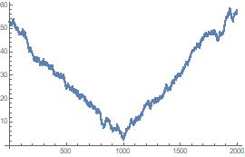

Trajectory 8
What is the state for T(8)?
$$T(8)=8,11,15,10,13,17,23,31,41,55,73$$
$$T^{−1}\left(8\right)=8,12,18,27,20,30,45,34,51,38,57$$
Exponential function
Log (ln) plot of naturals
On the Figure we can observe the joint sequences of T(8) for 1000 naturales in both directions

Slide 4
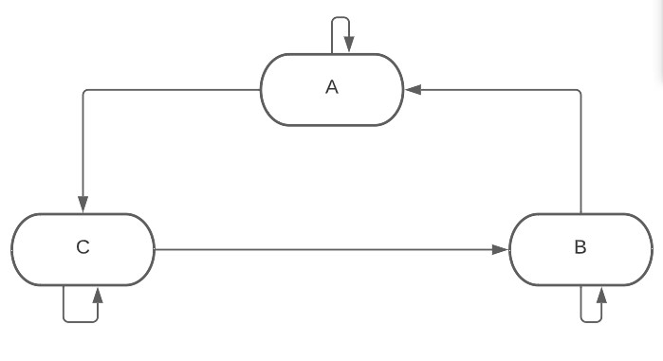

Order of operators
We relax the assumption that $x∈N^{+}$ for $x∈R^{+}$
We compute n steps using only CA and BA, creating an upper and lower bound
Repeat the process for the reverse direction and Permutation 2
Amount of usages of operator B and C, is p, and q for operator A
Theorem 1:$v = \left\{3^{n−p} \left(4^{p}−3^{p}\right)+{(2}^{n+p}−3^{n}\right)x,\left\{3^{n−p} \left(4^{p}−3^{p}\right)+{(2}^{n+p}−3^{n}\right)x\}$

Slide 5
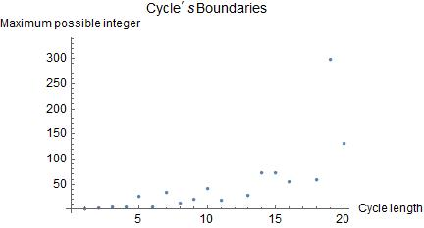

Exact theory analysis
Corollary 1: $x≤\max_{p}{\frac{3^{n−p}(4^{p}−3^{p})}{|2^{n+p}−3^{n}||}}$
Theorem 2:
$x> \frac{4λ^{n}}{3}$ , $λ=\frac{3^{\log_{2}{\frac{16}{3}}}}{8c}≈3.090343$
We create an upper bound integer, which delimits the maximal possible integer on a cycle of lenght n
Theorem 2, eleminates all small cycles

Slide 6


Bernoulli distribution
Probabilistic model
$X_{i}=\left\{\begin{matrix}\frac{2}{3}x_{\left\{i−1\right\}}→\frac{1}{3} \\ \frac{4}{3}x_{\left\{i−1\right\}}→\frac{2}{3} \\ \end{matrix}\right.$
$X_{i}=\left\{\begin{matrix}\frac{3}{2}x_{\left\{i−1\right\}}→\frac{1}{2} \\ \frac{3}{4}x_{\left\{i−1\right\}}→\frac{1}{2} \\ \end{matrix}\right.$
Natural model of the mapping is the Bernoulli (Binomial distribution) of 3-sided coin.
Each operation is treated as a side of the coin with probability 1/3
For inverse mapping the probabilities change to ½ due to the operator 2n
Independence of events, lose information
Assumption: $X_{i} mod 3$ are random

Slide 7
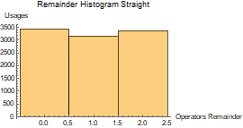
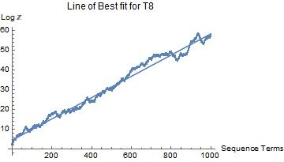

Growth rate Prob. Model
We trying to understand what extend the model reflects the actual behaviour
The mapping is expected to grow exponentially
The expected growth rate for a 3 sided coin is in the straight direction is:
$$E\left(\log{T}\left(x\right)\right)=1/3\log{\frac{2}{3}x}+\frac{2}{3}\log{\frac{4}{3}x=0.056633}$$
While for the reverse sequence is $0.0588915$
Line of best fit for T(8);
$$y= 4.48471+0.0539307 x$$
Every starting point is a local minimum

Slide 8
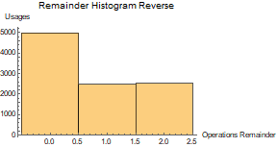
Steps to Reject or justify the PM
Absolutely nuclear, which model can produce such pathological behaviour
Asymmetric growth rate.
Are the operators chosen randomly for every trajectory?
Large scaterring in growth rates
Are the improbable events inside the standard deviation values?
Are these random events or pseudorandom events?
Trajectories starting at N | Last Natural | Growth rate | Last natural reverse | Growth rate reverse
57016 | 1293416 | 0,0513 | 1317646536 | 0,1197
66544 | 6038572 | 0,0715 | 48057966 | 0,0307
74812 | 6788809 | 0,0335 | 432233850 | 0,069
79376 | 57623935 | 0,0574 | 114649911 | 0,0660
17582 | 204223562 | 0,0983 | 101578833 | 0,0741

Slide 9

Cycles characteristics
44 → 59 → 79 → 105 → 70 → 93 → 62 → 83 → 111 →74→ 99 → 66 → 44
$Log_{2}3=2−\frac{X}{L},$where L is the length of the cycle and X the number an operator is used
Known, $\left|\frac{3}{2}\right|>c ,c>0.57434$
$\left|3^{q}−2^{p}\right|=2^{c}$, manipulating the logarithmic expression to understand the proportions between the selection of each operator, rate of approximation
Continued fraction expansion, rational number
We can approximate an upper and lower bound for the expected cycles, by runnning a recursive process to predict the posible starting point for such cycles

Slide 10
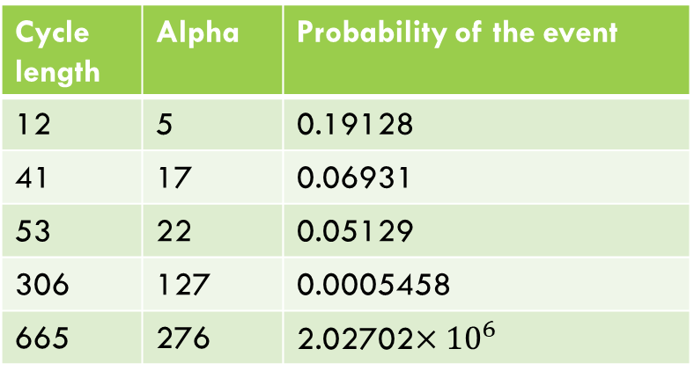

Expectancy of a cycle and its lenght
$\left(\frac{68}{69}\right){\left(\frac{3}{4}\right)}^{p}=\left(\frac{68}{69}{\left(\frac{3}{4}\right)}^{\log_{2}{\frac{3}{2}}}\right)≈{0.833}^{n}$
$E\left(s\right)=\sum_{n}^{∞}{{\left(\frac{68}{69}\right)}^{n}, n<∞}$
$E(s)≈4692$
$alpha=q$ is the usages of operator A
Cycle length | Alpha | Probability of the event
12 | 5 | 0.19128
41 | 17 | 0.06931
53 | 22 | 0.05129
306 | 127 | 0.0005458
665 | 276 | 2.02702$×{10}^{6}$

Slide 11
Cycles
Known Cycles | Permutation 1 lengths | Permutation 2 lengths | Permutation 3 lenghts
2 | 2 numbers
4 | 6 numbers
44 | 12 numbers
5 |  | 2 numbers
7 |  | 2 numbers
2 |  | 1 number
8 |  | 12 numbers
12 |  | 3 numbers
19 |  | 4 numbers
6 |  | 5 numbers
37 |  | 12 numbers
18 |  | 35

Slide 12
Cycles’ results

Slide 13
Questions
Tuthor: Ilia Krasikov
MMath and MA5640 project

